Slide 1
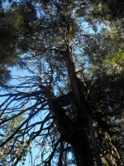
Blogging
Journeys
Evolving personal narratives, stories, reflections, and perspectives
GLENN GROULX

Slide 2
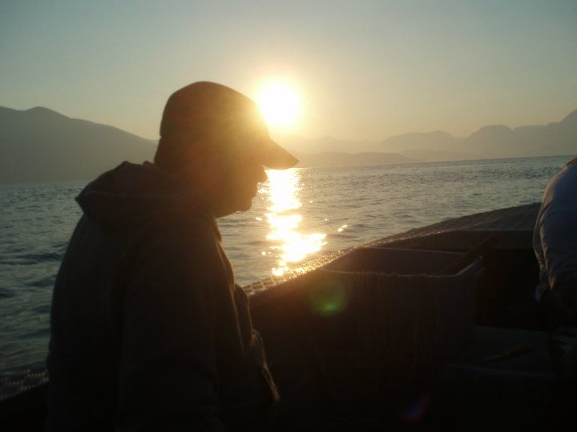
Crossing Paths, Crossing Rivers

Slide 3
Blogging Life-Streams
Professional
Hobbies and Interests
Formal Learning
Personal

Slide 4

Blogging as Transitioning

Slide 5
Blogging as Liminality
“betwixt and between”
blogging implies a constantly shifting relationship between the author and the written text
blogging gives rise to tentative, provisional output
blogging enables changes of mind
Blogging captures an individualized shifting of “signature” and “persona”

Slide 6
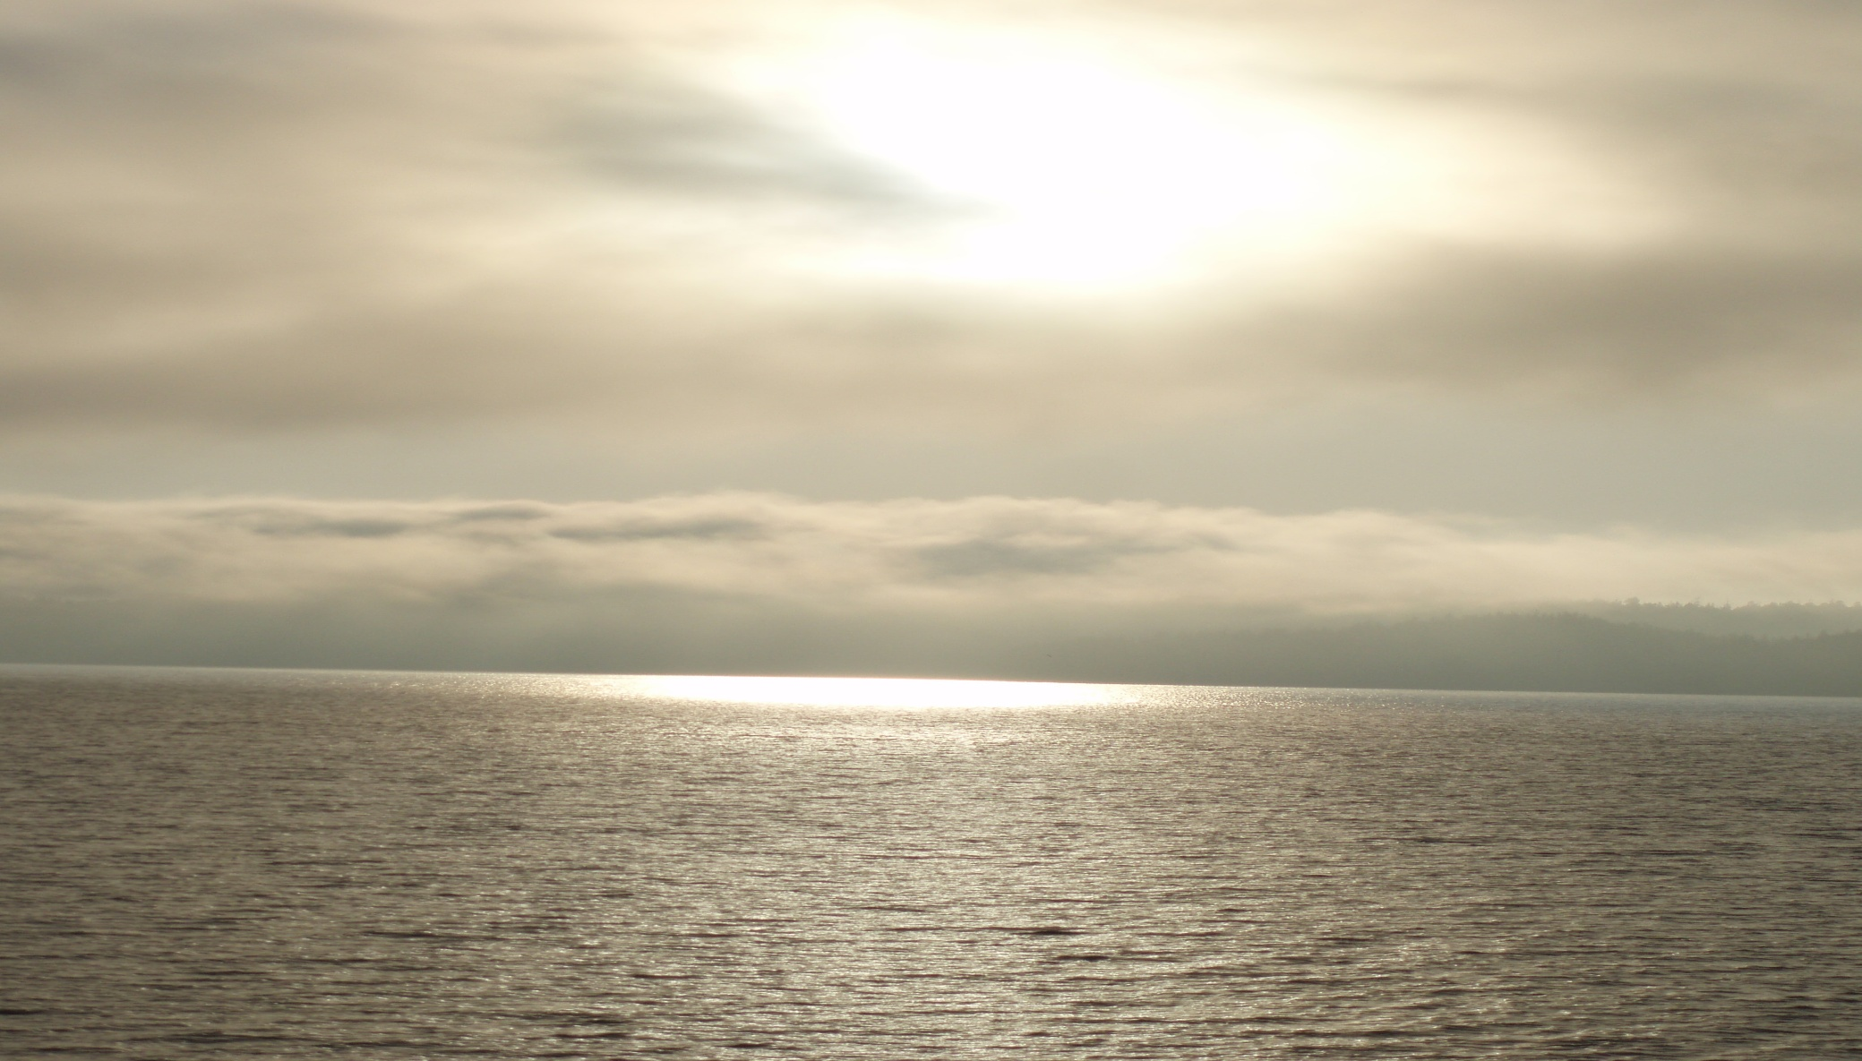
Reflecting on Oneself and Others

Slide 7
Blogging as Self-Reflection
“carving out private discursive spaces for contemplation”
Creating both “stilled reflections of life, as well as constructing life”
Retrieving, revisiting, reviewing and revising earlier posts sparks transformative growth

Slide 8
Blogging as Diarying
Diarying serves a number of personal needs:
  Confessional “le journal intime”(Didier)
  Therapeutic
  Chronicle
  Scrapbook
  Notebooks
Diarying NOT a “private” genre, but preferred by private people (want the content secure, but addressing an audience – even of one)

Slide 9
Blogging as Epistolary Narratives
Joint diaries of transient, outlier groups
Letters are semi-public
Letters tell a serialized, unfolding story from different characters’ perspectives
Role-playing, rehearsing, remembering

Slide 10
Blogs as Captured Dialogues
Ego-documents (revisits of past, reified memories)
Joint diaries (communal sharing)
Educational biographies (perspective transformation; use in PLAR)
Portfolios (summative assessment)
Story-telling (play-building)

Slide 11
Blogging as Social Rituals
Collective means of expression to record and exchange spiritual and intellectual journeys to each other
Communicating beliefs, values, and knowledge across time and space with like-minded audiences

Slide 12
Blogging as Performance
Blogging includes an addressee, and involves an act of communication towards:
  Imaginary friends
  World at large
  God
  Oneself in past, present or future
  The mirrored “Other”
  The imagined self

Slide 13
Challenges for Student Bloggers
Engaging in creating personal educational biographies
Synchronizing one’s ideas with others
Testing evaluations and impressions
Engaging more comfortably in active self-disclosure
Resolving confusion over expectations of transparency, reciprocal exchange and addressivity
Strengthening ties by swapping resources

Slide 14
Blogging Activities
Building and Sharing Blogging Profiles
Swapping Experiences with Way-Making
Select, Collect and Contribute Links to Tools, Experts, and Bookmarks
Engaging in Cooperative Sense-Making
Reflective Summaries

Slide 15
Sharing and Building Blogging Profiles
Learners develop their profiles as a learner and explain what they would like to do with their blogs, and what skills they would like to develop.
Learners read and reflect on the profiles of others – which are similar, and which are quite different.

Slide 16
Swap Experiences with Way-Making
Learners swap best ways to find useful bloggers and resources online, and describe the content of the expert blogs and sites in a series of blog posts.
Learners describe how others’ blogs (peers, expert bloggers, instructor) have influenced their blogging activities.

Slide 17
Select, Collect and Contribute Links to Tools, Experts, and Bookmarks
Learners share their initial hit and miss activities online while searching for useful resources
Learners summarize and annotate useful resources, posting summaries and reviews for peers as bookmarks, links and RSS Feeds

Slide 18
Engaging in Cooperative Sense-Making
Learners document their selection, drafting and writing process
Posts containing unrefined ideas are shared through short snippets – include self-questioning, working notes, and links to both active and dormant content
Posts build on and weave together various sources (one’s own earlier posts, feedback from instructor and peers, resources, articles, etc.)

Slide 19
Reflective Summaries
Learners look back at own postings, and compare to expert bloggers, peers, and instructor’s posts;
Learners reflect on challenges, lessons learned, skills and knowledge gaps, and positive experiences as well as frustrations;
Learners read and comment on peers’ reflections to apply to their own future blogging practice

Slide 20
“Blogging itself becomes a (real life) experience, a construction of self that is always mediated by tools for communication and experience.”
Jose van Dijck, Composing the Self: Of Diaries and Lifelogs, 2004, page 8; URL: http://journal.fibreculture.org

Slide 21
Questions and Discussion
Glenn Groulx
Twitter: @ggroulx
Email: ggroulx@nwcc.bc.ca
Literacy Blog:
http://edublogging4literacy.edublogs.org
EduBlog: https://landing.athabascau.ca/pg/blog/glenngr4

