Slide 1
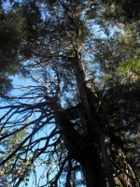
Glenn Groulx, B Ed., MDE
Introducing Edu-Blogging

Slide 2
Presentation Overview
Blogging platforms
Blogging perspectives and settings
Blogging as mentoring
Cohort blogging
Seminar blogging
Autonomous blogging
Blogging paradigms
Implications
Questions and discussion

Slide 3
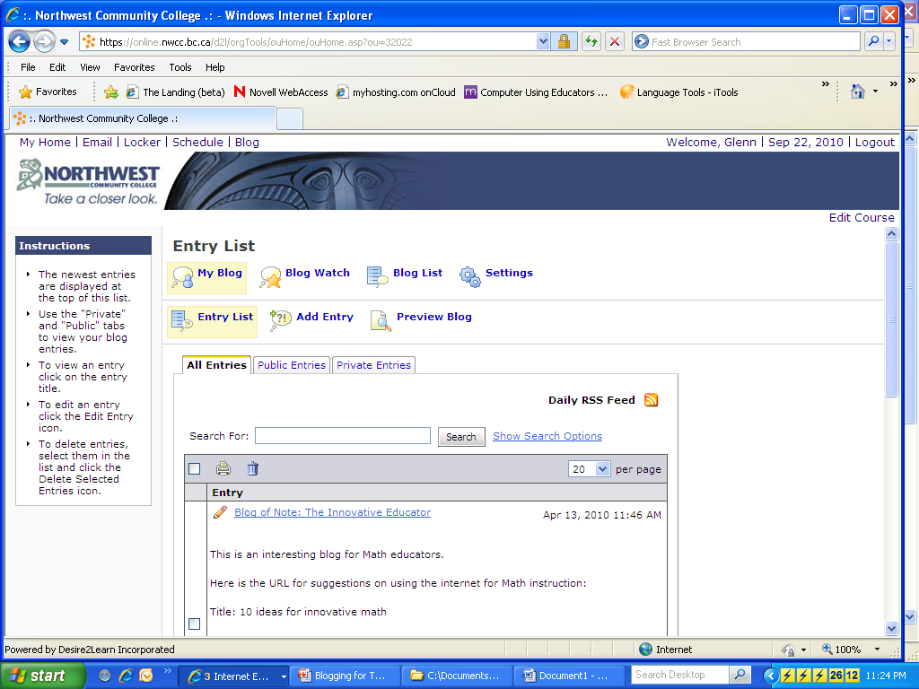

Slide 4


Slide 5
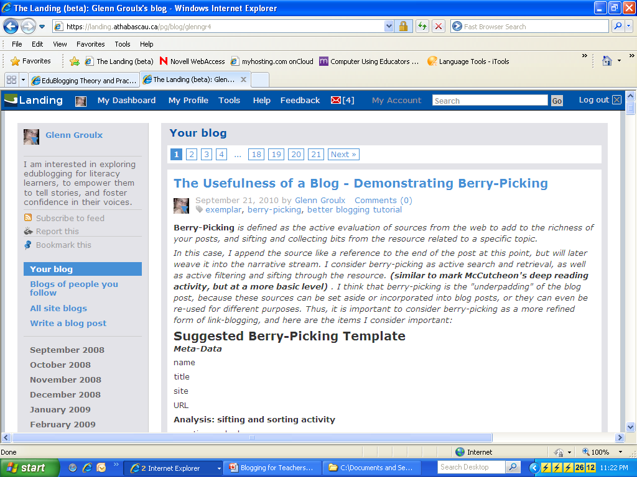

Slide 6
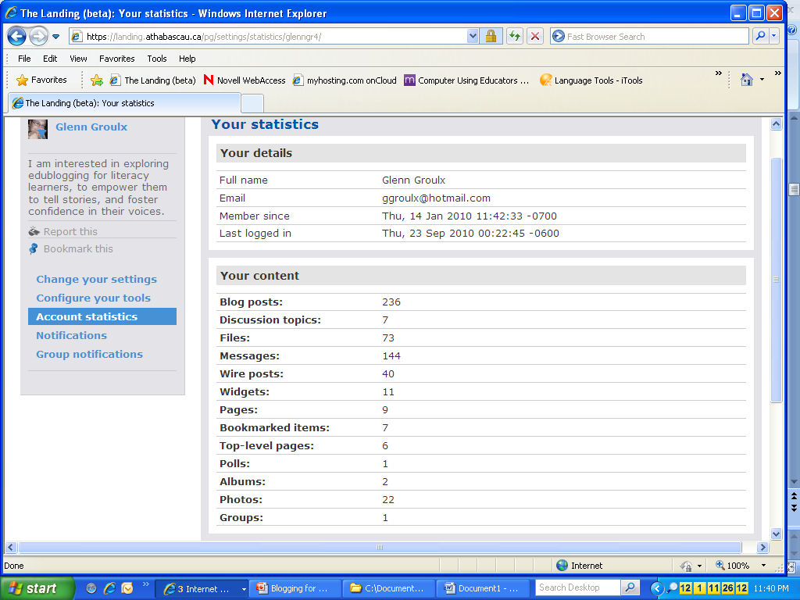

Slide 7
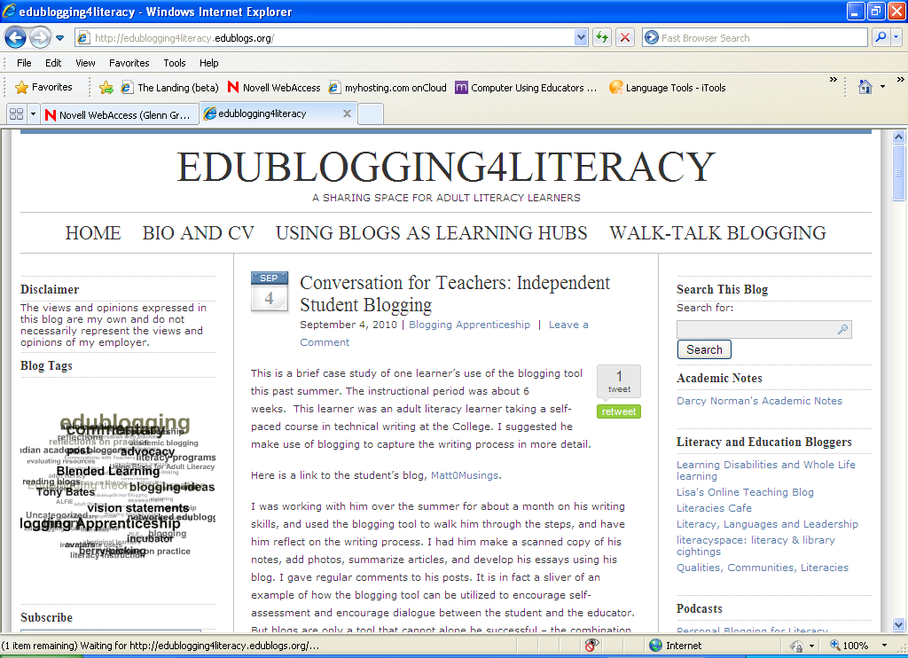

Slide 8
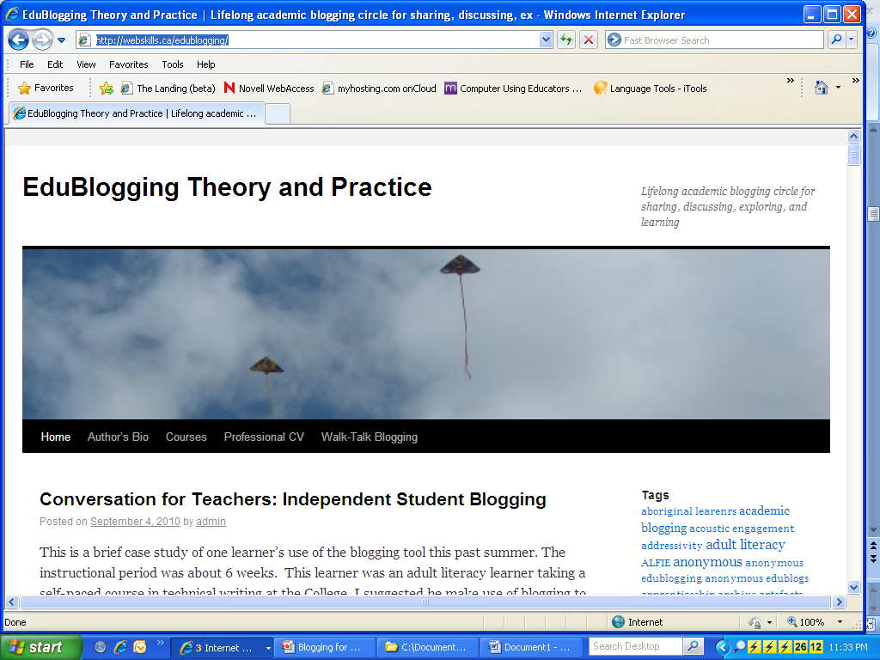
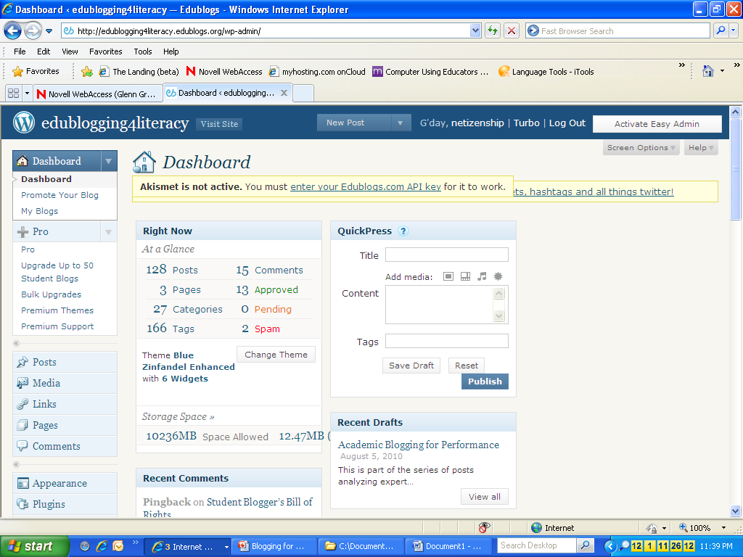

Slide 9
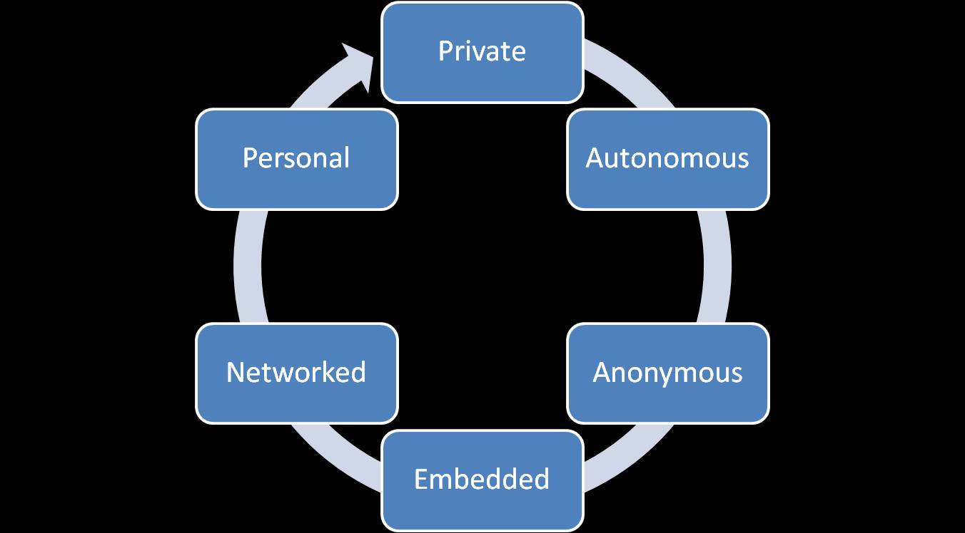
Blogging Perspectives

Slide 10
Blogging Settings
Cohort
Seminar
Blogging Circle
Practice Network

Slide 11

Blogging as Mentoring

Slide 12
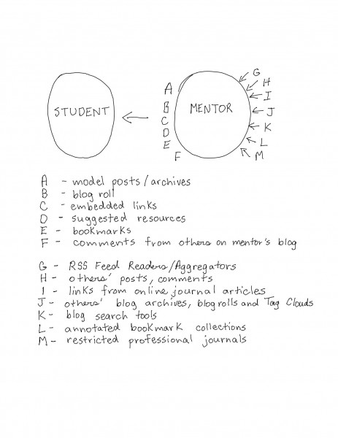
Blogging as Mentoring

Slide 13
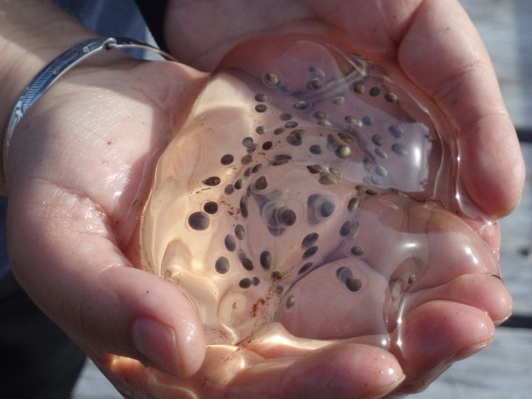
Blogs as Incubators

Slide 14
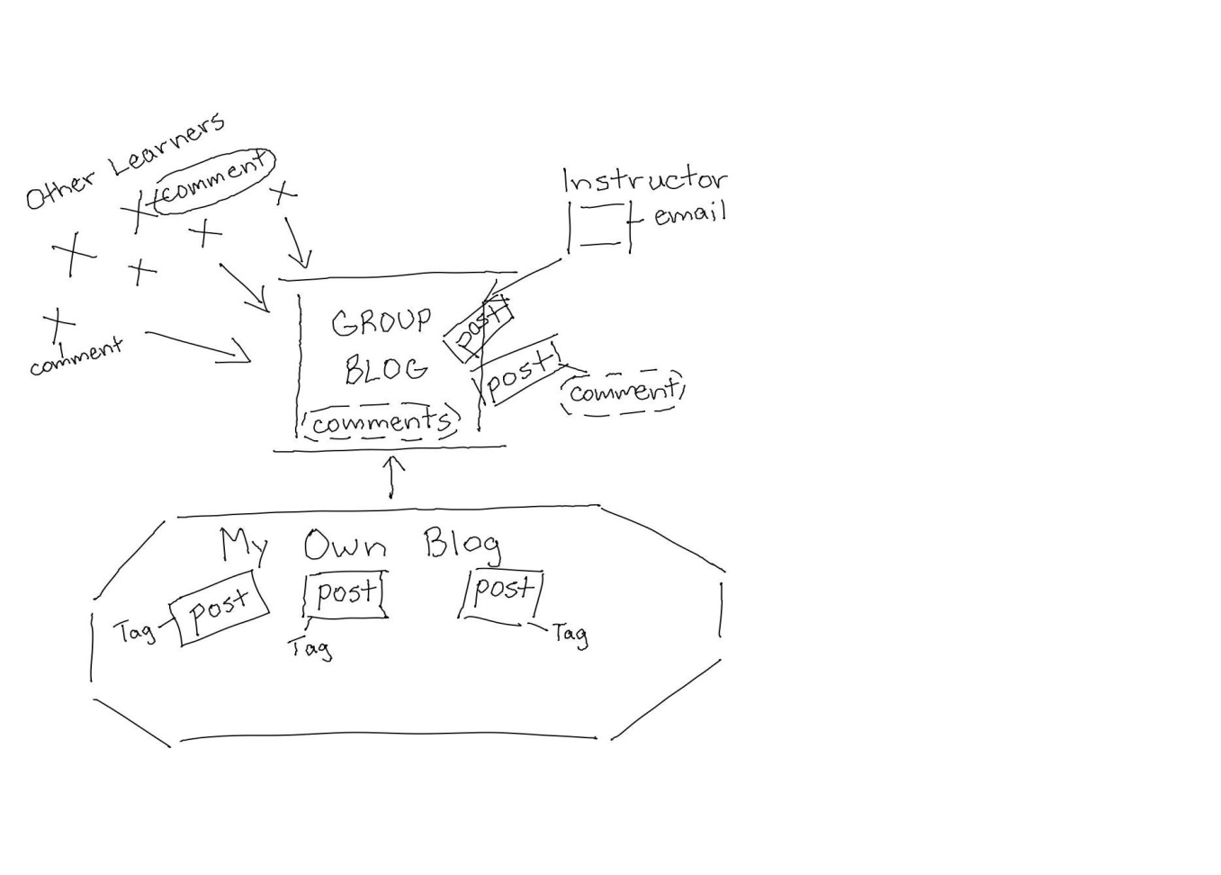
Cohort Blogging
Students blogging to review content specific to course
Group blog central focus
Limited interaction between learners as peers; mainly with instructor
Commenting main form of interaction between instructor and learners
Tags sometimes used to categorize posts
Uncertainty and ambivalence common attitudes in learners

Slide 15
Cohort Blogging
  Peer interaction
  Article critiques
  Reflective posts
  Weaving ideas
  Sharing resources
  Summary reflective posts
  Making initial connections with some peers (buddy system)

Slide 16
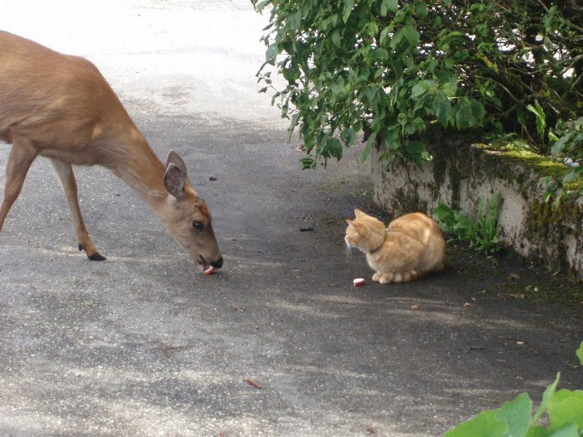
Blogs as Encounters

Slide 17
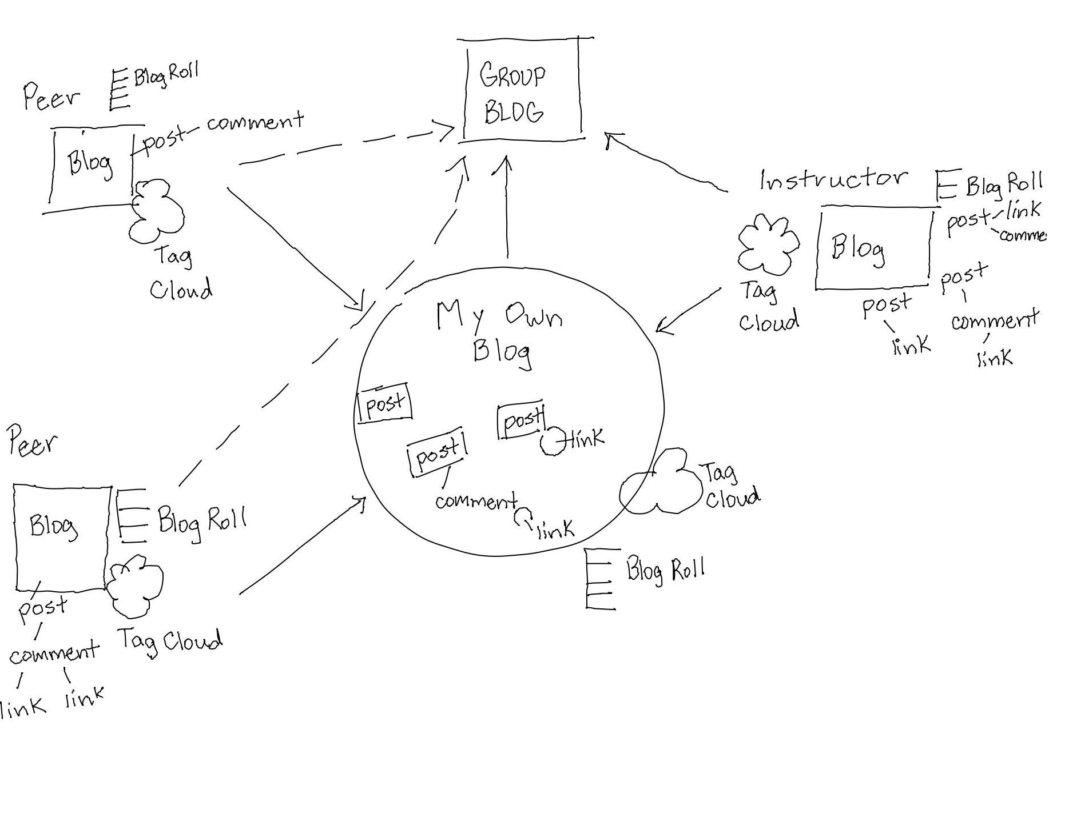
Seminar Blogging

Slide 18
Seminar Blogging
  Creation of annotated bookmarks
  Organizing posts for easier retrieval and re-use (piling)
  Pause-points (self-monitoring of progress made)
  Weaving ideas from articles, web sites, blog posts
  Receives feedback mainly from instructor, sometimes from peers
  Critical discussion created extended conversation as comments, then moved to individual blog posts
  Sharing resources and experiences
  Summary individual presentations of seminar topics to group

Slide 19
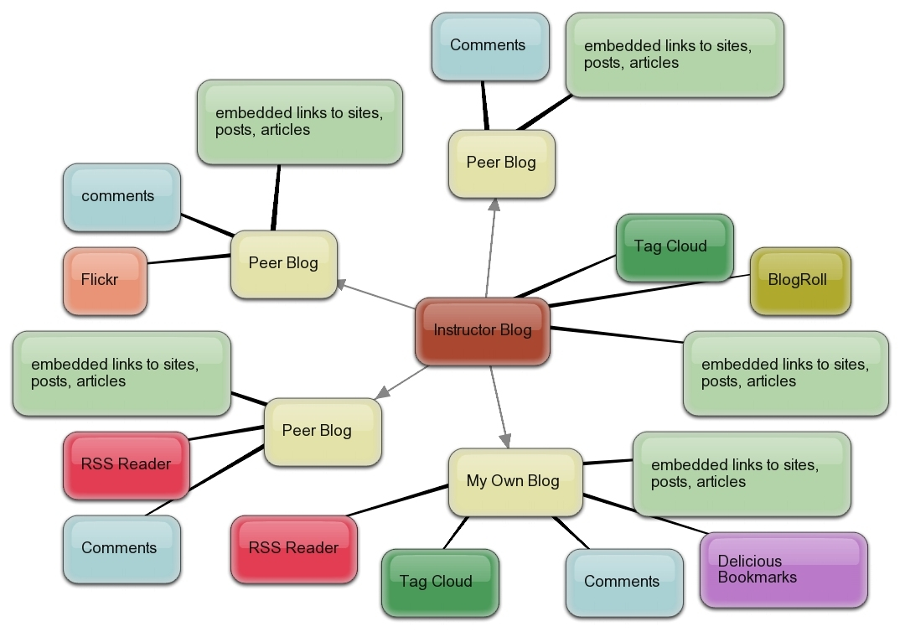
“Blogging Circle”

Slide 20

Blogs as Explorations

Slide 21
Autonomous Blogging within the Blogging Circle
  Re-tagging of posts
  Revisiting, revising earlier posts
  Weaving ideas from own posts into subsequent posts, as well as weaving comments, articles, web sites, and others’ blog posts
  Receives feedback mainly from instructor, sometimes from peers (not part of cohort or course)
  Engages in self-talk, ideas capture
  More proactive; more engaged with purposeful posting

Slide 22
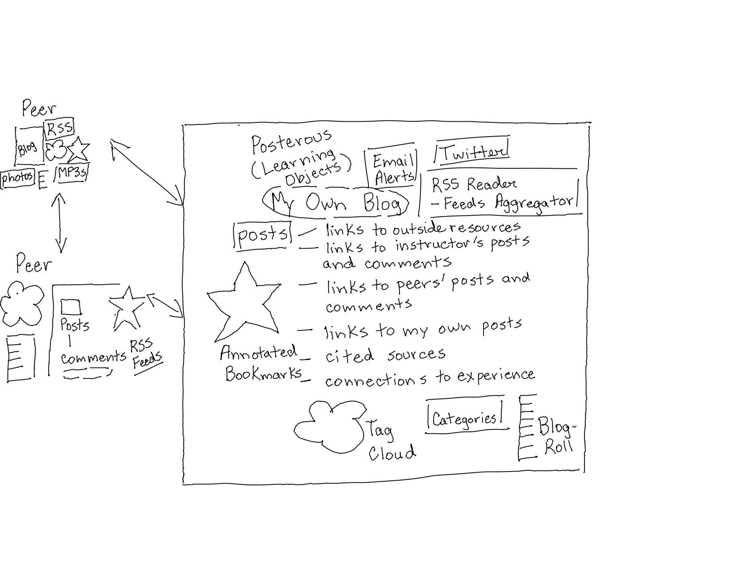
Blogging for Academic Networking

Slide 23
Autonomous Blogging Within the Practice Network
  Extensive Re-tagging, Revisiting, and Revising earlier posts
  Participates as observer/guest with other groups of students in addition to completing own course work
  Engages in resource-sharing as well as path-sharing with group
  Continues to engage in self-talk, ideas capture
  Primarily self-regulated learning, with instructor as observer/guide
  Draws sources from other blogging experts outside institution

Slide 24
Blogging Paradigms
Class Blogs
(Cohort)
Instructivist
Teacher-supported and moderated
Cooperative Blogs (Seminar)
Constructivist
Peer Blogging
Collaborative Blogs (Blogging Circle)
Transformative
Buddy-Blogs;
Autonomous Blogs
(Practice Network)
Connectivist
shifting perspectives and goals of lifelong blogger
Private Journaling
Students do not control or own posts
Anonymous (performance) blogging

Slide 25
Implications for Academic Blogging
Blogging needs to be introduced to new student bloggers within a supportive context, so that newcomers are provided aid and resources by more experienced peers and facilitators.
Collaboration with beginners is best supported by a core group of experienced student and facilitator bloggers who are willing to provide aid/support.
All learners and teachers should be more actively encouraged to practice sustained long-term blogging within these four learning contexts: Cohort, Seminar, Blogging Circle, and the Practice Network.

Slide 26

Questions and Discussion

Slide 27
Thank you!
Glenn Groulx
ggroulx@nwcc.bc.ca
http://edublogging4literacy.edublogs.org/

