Slide 1
Academic Blogging in Practice:
A Case Study
CeLC 2010 Presentation
Edmonton, AB
June 2010

Slide 2
Introduction to Case Study
Completed 4 courses of 11 course MDE program at Athabasca University
16 months of uninterrupted blogging practice
September 2008 to December 2009
4 semesters of sustained, continuous activity
Blogged within Me2U at Athabasca University
Maintained contact with one professor as mentor during four consecutive semesters

Slide 3
Academic Blogging Described
Formal instruction within academic institution
Student bloggers supported by instructor and by their peers
Blogging activities are within formal practice network
Student bloggers need to practice blogging over several semesters
Students need to be provided plenty of exemplars and scaffolding to engage in blogging in several different learning contexts
Students need to be self-directed to blog autonomously with long periods of isolation
Students need to be assured their instructor is an avid blogger able to identify and support commonly encountered areas of concern and issues

Slide 4
Academic Blogging Apprenticeship
Cohort
Seminar
Blogging Circle
Practice Network

Slide 5
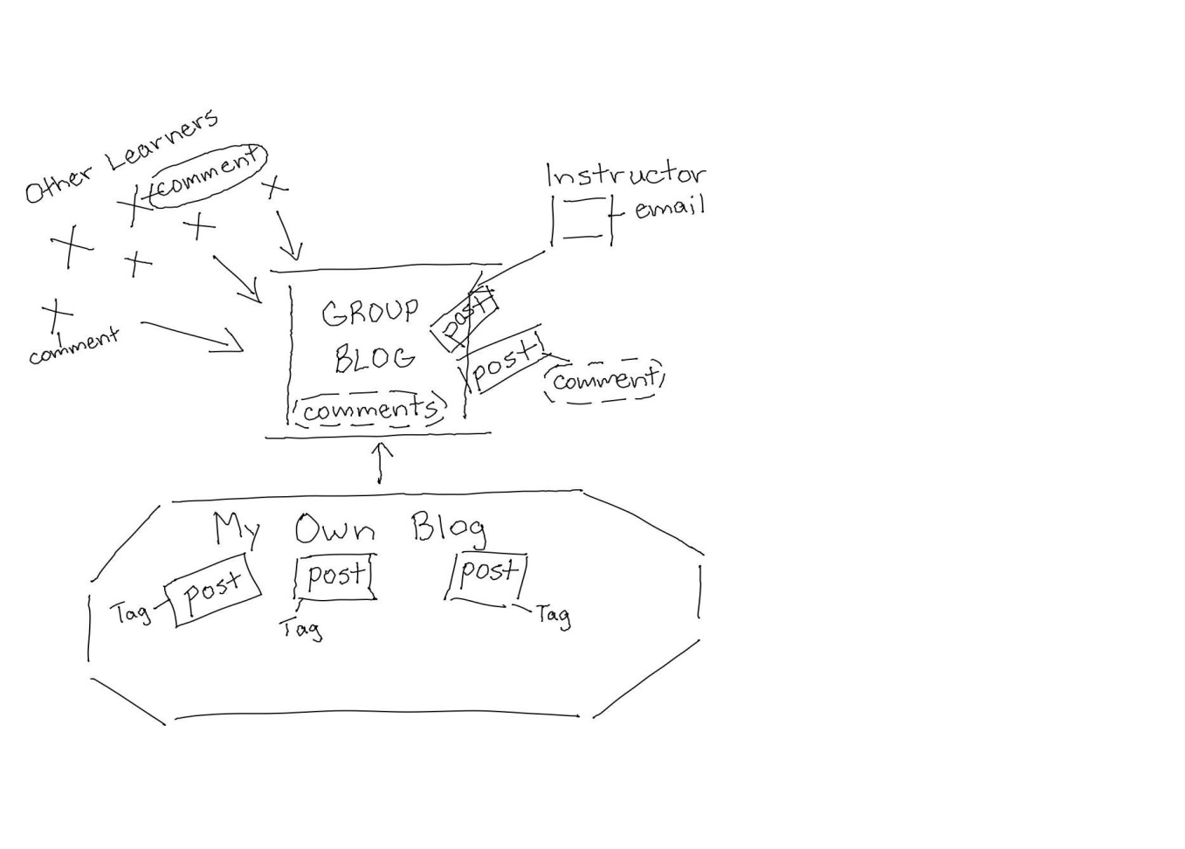
Cohort Blogging
Students blogging to review content specific to course
Group blog central focus
Limited interaction between learners as peers; mainly with instructor
Commenting main form of interaction between instructor and learners
Tags sometimes used to categorize posts
Uncertainty and ambivalence common attitudes in learners

Slide 6
Cohort Blogging
Semester One: (Cohort)
  Peer interaction
  Article critiques
  Reflective posts
  Weaving ideas
  Sharing resources
  Summary reflective post
  Made connections with some peers (buddy system)

Slide 7
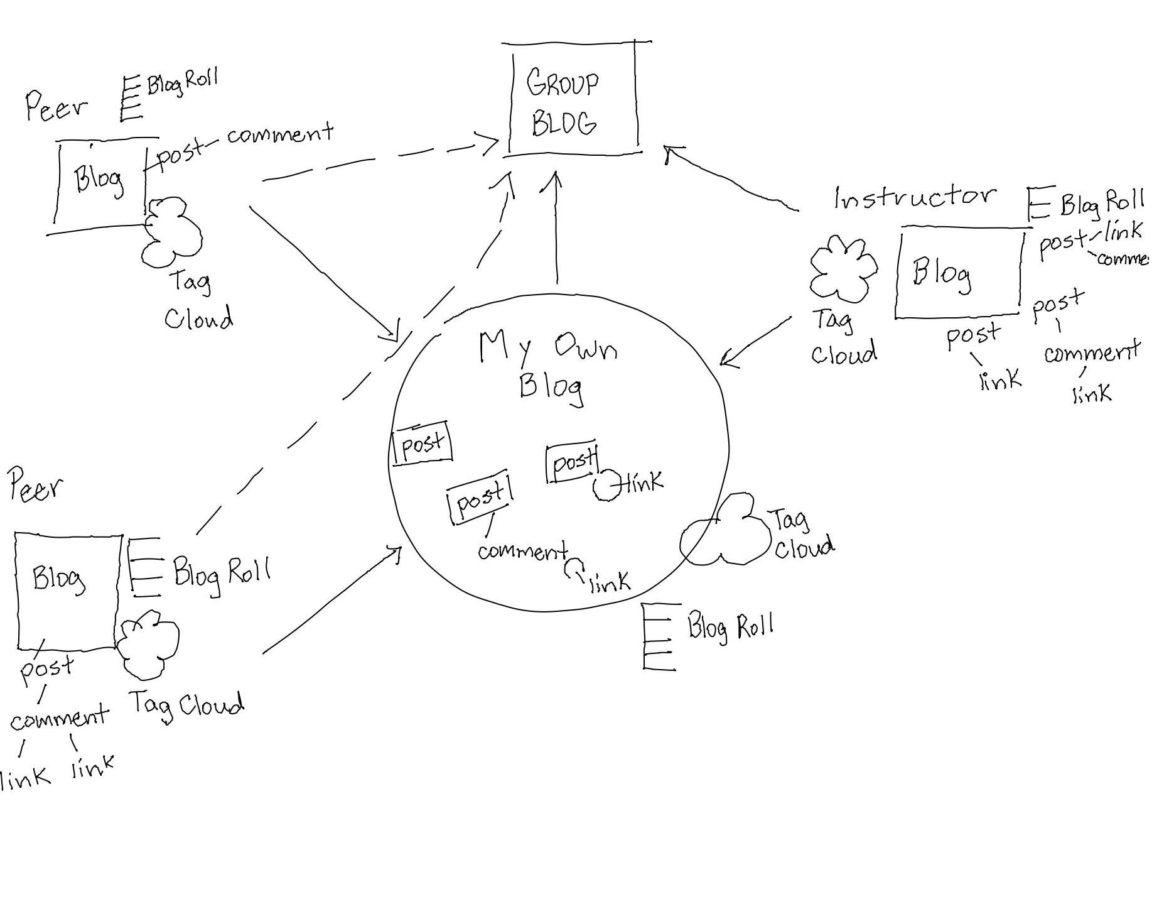
Seminar Blogging

Slide 8
Seminar Blogging
Semester Two: (Seminar)
  Creation of annotated bookmarks
  Organizing posts for easier retrieval and re-use (piling)
  Pause-points (self-monitoring of progress made)
  Weaving ideas from articles, web sites, blog posts
  Received feedback mainly from instructor, sometimes from peers
  Critical discussion created extended conversation as comments, then moved to individual blog posts
  Sharing resources and experiences
  Summary individual presentations of seminar topics to group

Slide 9
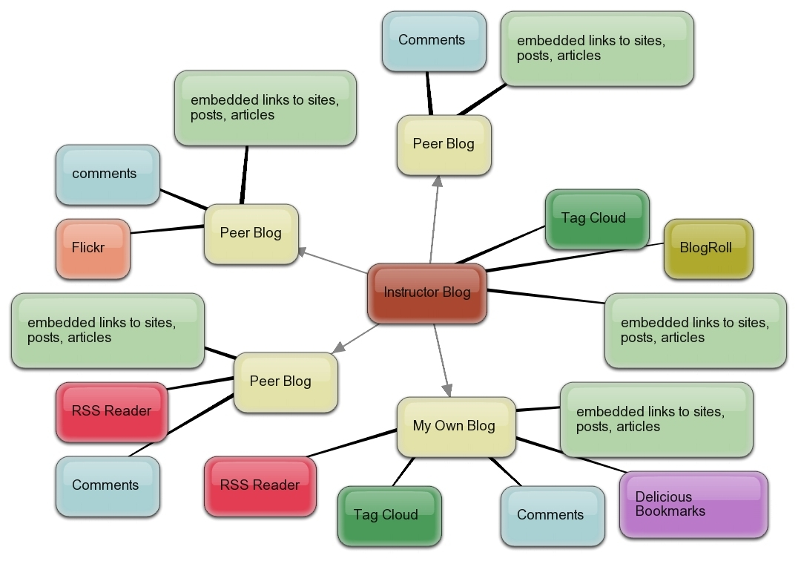
“Blogging Circle”

Slide 10
Autonomous Blogging within the Blogging Circle
Semester Three: (“Blogging Circle”)
  Re-tagging of posts
  Revisiting, revising earlier posts
  Weaving ideas from my own posts into subsequent posts, as well as weaving comments, articles, web sites, and others’ blog posts
  Received feedback mainly from instructor, sometimes from peers (not part of cohort or course)
  Engaged in self-talk, ideas capture
  More proactive; more engaged with purposeful posting
  For final presentation, presented to CIDER

Slide 11
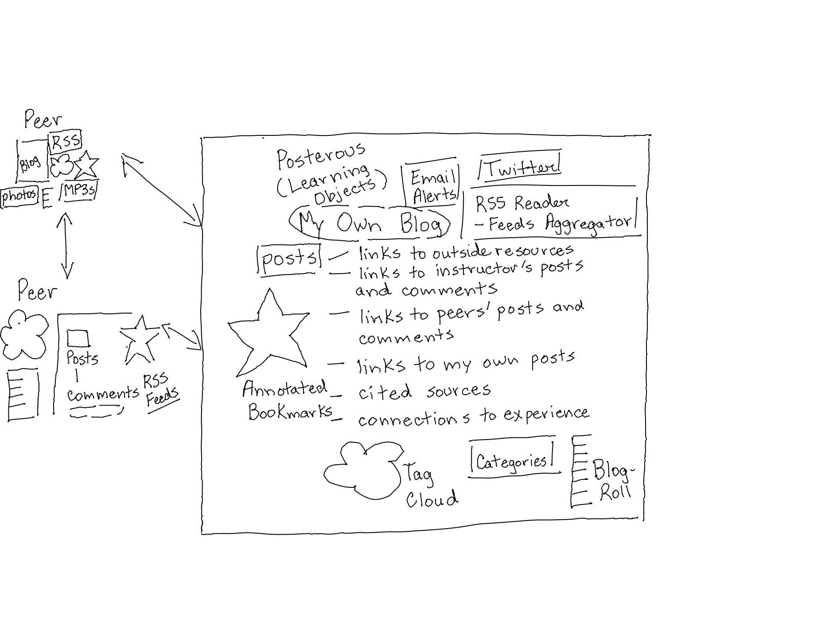
Blogging for Academic Networking

Slide 12
Autonomous Blogging Within the Me2U Practice Network
Semester Four: (Network of Practice)
  Extensive Re-tagging, Revisiting, and Revising earlier posts
  Participated as observer/guest with group as former student, in addition to completing own course work
  Engaged in resource-sharing, as well as path-sharing with group
  Continued to engage in self-talk, ideas capture
  Primarily self-regulated learning, with instructor as observer/guide
  Drew sources from other blogging experts outside institution

Slide 13
Qualitative Analysis
How to describe these blogging activities over the four semesters?
What were the conditions that enabled this type of learning experience?
What common patterns of blogging activity emerged from the posts?
What variables remained constant?
Was there a developmental process?
Were there some differences and similarities in the four learning contexts?
What were significant differences/similarities in blogging skill over the fifteen months?

Slide 14
Theoretical Background
Weick, Sutcliffe, and Obstfeld, sense-making
Marcia Bates, Berry-picking
Stephen Downes – ARRFF process (Aggregate-Remix-RePurpose-FeedForward); mesh networks
Lilia Efimova – Sense-Making process (Awareness–Articulation-Sense-making - Product Creation)
Du and Wagner - “thinking by writing”; cognitive and social knowledge construction and representation
Jon Dron & Terry Anderson, “Groups, Networks and Collectives”
George Siemens, Connectivism

Slide 15
Selection and Collection of Data
Blog post was unit of analysis
No log files available
Tag Cloud
Commonly Used Tags: Edublogging, MDDE663, MDDE690, MDDE691, MODEL POST, and Reflections
29 connections were established with other peers within the Me2U community;
I blogged a total of 159 posts and classified these posts with 330 tags
Used Transcript Analysis on posts to count number of events of knowledge building and network building activities over four semesters

Slide 16
Knowledge-Construction Process Cycle
Berry Picking
Path Finding
Path Making
Sense-Making
Path Sharing
Sense-Giving
Piling
Weaving

Slide 17
Event | Description | Cohort | Seminar | Blogging Circle | Practice Network
Berry-Picking | Identify, evaluate, and select resources; collect ideas, links and references | 1 | 1 | 7 | 5
Piling | Classify posts, categorizing and sorting; adding tags and categories | 2 | 8 | 30 | 19
Weaving | Summarizing content; embedding links into posts; adding quotes and citing sources | 5 | 8 | 17 | 17
Path-Finding | Searching for resources; Identifying , selecting and evaluating tools | 1 | 0 | 1 | 7
Path-Making | Formalizing search and collection routines and strategies | 0 | 3 | 2 | 6
Sense-Making | Rehearsals; self-talk; pause-points; elaborating, evaluating, and analyzing ideas | 15 | 20 | 34 | 23
Path-Sharing | Sharing experiences; mentoring others on skills and knowledge required for path-finding, path-making, and sense-making | 1 | 1 | 13 | 13
Sense-Giving | Pass along experiences, model skills, reporting, exchanging ideas, acting as witness, observer, and commenter. | 4 | 5 | 17 | 14

Slide 18
“Knowledge Construction activities involve individual learners’ engagement with content while using blogs for learning.”
Cohort – 29 (10%)
Seminar – 46 (15%)
Blogging Circle – 121 (40%)
Practice Network – 104 (35%)

Slide 19
Discussion
Of 300 “events” in which different processes of knowledge construction were demonstrated through blog posts, only 21 events, or 10%, were demonstrated within the first semester
121 events, or 40%, were demonstrated during the third semester, when I blogged entirely independently under the guidance of a mentor, during the summer months without support of a cohort of peers
During the fourth semester, 104 knowledge construction events, or 35%, were demonstrated, more than twice as many events as during the second semester.

Slide 20
Network Construction Process Cycle
Aggregate
Re-Use
Re-Mix
Feed Forward
Process Capture
Product Creation
Review
Awareness
Articulate

Slide 21
“Network Construction activities involve individual learners’ engagement through dialogue and collaboration with others.”
Cohort – 24 (13%)
Seminar – 52 (27%)
Blogging Circle – 39 (20%)
Practice Network - 77 (40%)

Slide 22
Event | Description | Cohort | Seminar | Blogging Circle | Practice Network
Awareness | Scanning, reading, and reviewing of online resources, identifying gaps in skills & knowledge | 3 | 7 | 2 | 5
Articulation | Explorations within and beyond instructor’s blog, group blog and peers’ blogs; description of initial activities | 6 | 9 | 5 | 5
Aggregate | Bring together content, links, profiles and identify usage patterns | 5 | 6 | 1 | 11
Re-Use | Re-examination, culling, filtering, re-organizing; revising blog content: posts, feeds, comments; may involve return to drafts or weaving emails or work from assignments into new blog posts | 1 | 1 | 1 | 5
Re-Mix | Draw ideas from multiple sources, then summarize, analyze, and report on ideas | 2 | 8 | 10 | 16
Feed-Forward | Sharing, exchanging, story-telling to audiences | 1 | 8 | 6 | 14
Process Capture | Systematic recording of thought processes and ideas using multiple media | 2 | 3 | 5 | 10
Product Creation | Preparation, planning, and performing of learning events; reflection in practice | 1 | 8 | 7 | 6
Review | Post-performance summary, critique, summary reflections | 3 | 2 | 2 | 5

Slide 23
Discussion
Of 192 networking construction events in total over 15 months, 13% occurred during cohort blogging, and doubled during seminar blogging to 27%.
Network construction events dropped 7% in the third semester, to 20%, when I was blogging within a blogging circle.
There were twice as many networking construction events when I blogged within the Practice Network (77 events), than when I blogged just within a Blogging Circle (39 events).

Slide 24
Data Summary
Cohort – 53 (11%)
Seminar – 98 (20%)
Blogging Circle - 160 (32.5%)
Practice Network - 181 (36.5%)

Slide 25
Summary of Data:
Overall Blogging Activity

Slide 26
Discussion
During blogging within the Blogging Circle (semester 3), there were four times more knowledge construction events than network construction events.
Also, the number of total construction events during semester 3 (Blogging Circle) were three times greater than semester 1 (Cohort).
There were three times more network construction events during blogging within the Practice Network (semester 4) than within the Cohort (semester 1).
Twice as many network construction events occurred in semester 2 (Seminar blogging) than in semester 3 (Blogging Circle).
Both cohort and seminar blogging are more balanced with developing both knowledge and network construction processes in learners.
The Blogging Circle focuses on developing knowledge construction skills; the Practice Network focuses on developing network construction skills
The Blogging Circle and the Practice Network both generate more knowledge construction and network construction events than the cohort and the seminar combined.

Slide 27
Implications for Academic Blogging
Blogging needs to be introduced to new student bloggers within a supportive context, so that newcomers are provided aid and resources by more experienced peers.
By providing learners a support system of student mentors who have already established a rich, complex personal network, and who have already mastered the requisite skills in knowledge and network construction, fewer new student bloggers will face isolation.
Collaboration with beginners is best supported by a core group of experienced student/faculty bloggers who are willing to provide aid/support
All learners and faculty should be more actively encouraged to practice sustained long-term blogging within these four learning contexts: Cohort, Seminar, Blogging Circle, and the Practice Network.

Slide 28
Conclusions
Results are based on progression over four semesters as I developed skills in one setting that transferred to next settings – suggests that a blogging apprenticeship is required for learners
The case study supported the central role of peers in supporting learners.
It also provides strong support for the essential, central role of instructors.
Student bloggers require sustained opportunities to practice knowledge and network construction over several semesters in differing contexts, ideally with only one instructor.
As majority of my own construction events occurred as an autonomous student blogger within blogging circles and the Me2U practice network, more research is needed to investigate these types of learning contexts.

Slide 29
Selected Resources
Bates, Marcia J. "The Design of Browsing and Berrypicking Techniques for the Online Search Interface." Online Review 13 (October 1989): 407-424.Kerawaala (2009)
Downes, S. (2009). New Tools for Personal Learning. Retrieved December 7, 2009, from URL: http://www.slideshare.net/Downes/new-tools-for-personal-learning
Siemens, G. (2009). What is Connectivism? Week 1: CCK09 Course, Date: September 2009
Retrieved October 26, 2009 from http://docs.google.com/Doc?id=anw8wkk6fjc_14gpbqc2dt
Weick, Sutcliffe, and Obstfeld: Organizing and the Process of Sensemaking. Organization Science 16(4), pp. 409–421, ©2005 INFORMS
Du, H., & Wagner, C. (2007). Learning With Weblogs: Enhancing Cognitive and Social Knowledge Construction. IEEE Transactions on Professional Communication, 50(1), 1-16. Retrieved from Academic Search Premier database.
Efimova, L. (2009). Weblog as a personal thinking space. HT’09: Proceedings of the twentieth ACM conference on hypertext and hypermedia, June 2009. New York: ACM. doi:10.1145/1557914.1557963 [.pdf]

